Slide 1
Science – Chapter 11
“Matter and its Properties”

Slide 2
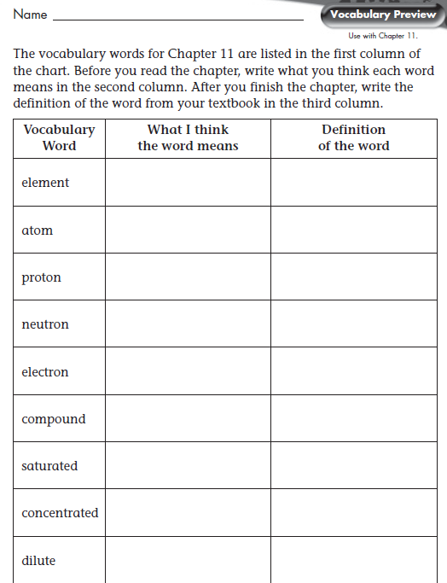

Slide 5
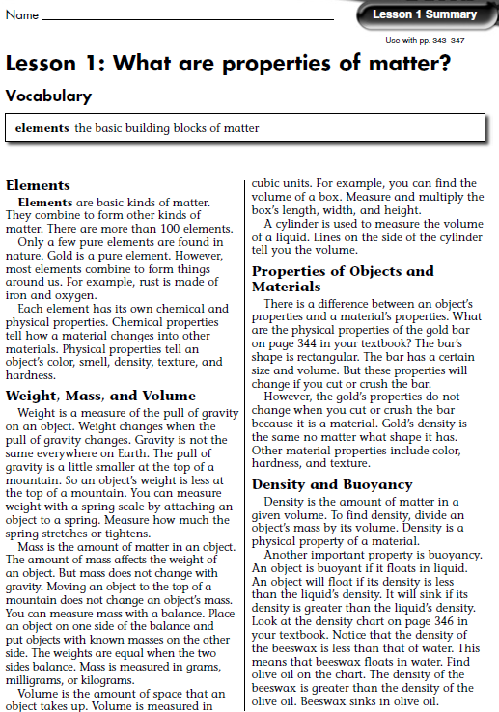

Slide 6
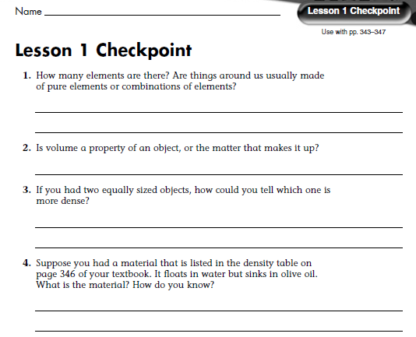
There are more than 100 elements. Most things are made of combinations of elements.
Volume is a property of the object.
The object with more mass will have a greater density.
Beeswax has a density greater than olive oil, so it sinks in olive oil. Beeswax has a density less than water, so it floats in water.

Slide 9
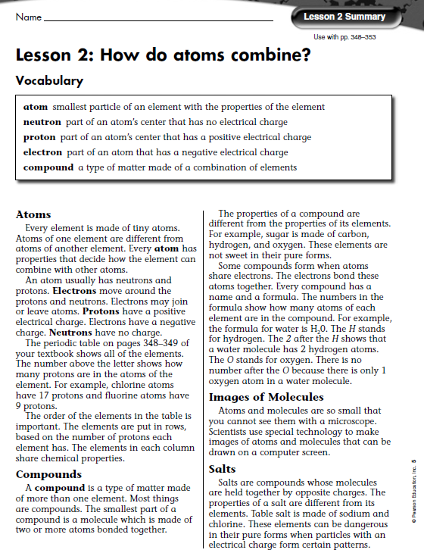

Slide 10
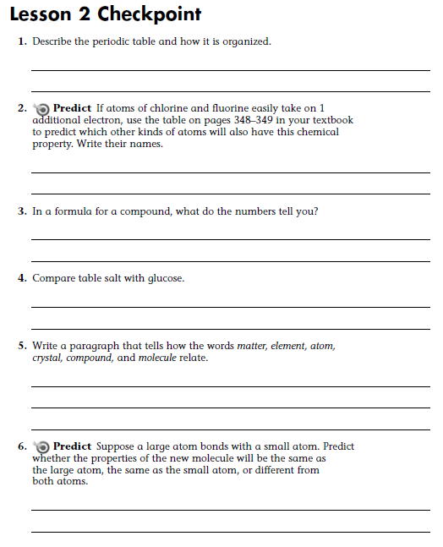
The periodic table shows all of the elements. The elements are put in rows, based on the number of protons each element has. The elements in each column share chemical properties.
Magnesium, Beryllium, Strontium, Barium, and Radium
The numbers in the formula show how many atoms of each element are in the compound.
Both table salt and glucose are white, powdery solids at room temperature. Both can be eaten. They have different tastes and are formed by different kinds of bonds. That have different atoms.
All matter is made of elements. The smallest particle of an element is an atom. Atoms combine to form molecules. One of the smallest particles of a compound is a molecule. In salts, charged particles form crystals.
The properties will be different from both atoms.

Slide 12
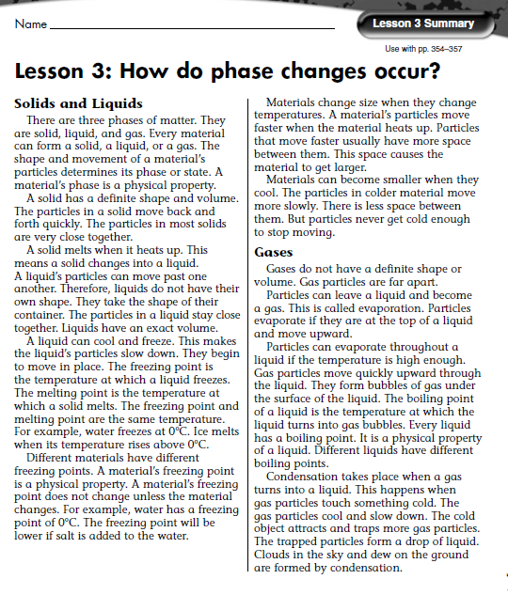

Slide 13
When atoms and molecules change temperature, they change speeds. Different speeds result in a different amount of space between the particles.
Atoms slow down and get closer together as they cool from a gas to a liquid and then to a solid. Typically particles do not get cold enough to stop moving.
Boiling point is the temperature at which a liquid boils. Melting point and freezing point are the same for a given material. This is the temperature at which a material either freezes or melts. Boiling points are hotter than melting/freezing points.

Slide 15
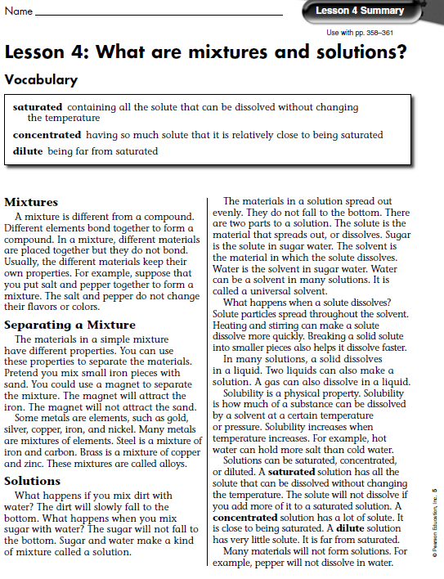

Slide 16
Gold, silver, copper, iron, and nickel are elements. Bronze, brass, and steel are mixtures.
Pepper does not make a solution in water. Pepper does not dissolve or spread evenly through the water. Salt and water can be called both a mixture and a solution. Salt dissolves and spreads evenly throughout the water.
By increasing the temperature or pressure of the solution, you can dissolve more solid.

